Slide 1
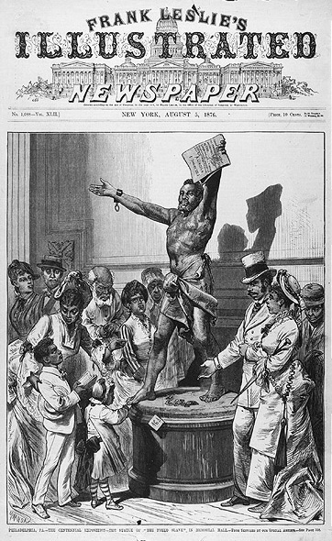
Reconstruction and the End of Civil War
1865
"There was one thing that the white South feared more than negro dishonesty, ignorance, and incompetency, and that was negro honesty, knowledge, and efficiency." - W.E.B. Du Bois, 1915
Man rejoicing after being released from slavery.
Since the Union won the war, they decided the Southern states would only be readmitted to the United States once they elected new governors and approved the 13th Amendment abolishing slavery. The freed slaves enjoyed new rights which included voting. This new right enabled the first black senator to be elected from Mississippi.
The South was devastated by the war. Railroads, bridges, and roads were destroyed in the South because that was where most of the war was fought. The North tried to help rebuild and set-up “fund shelters” to give rations, shelter, and jobs. However, Northerners, called “Carpetbaggers,” moved to the South to take advantage of these economic opportunities. Some Southerners did not appreciate the efforts to rebuild, others tried to make the best of it, and still others could not tolerate the loss of the war and left the country.
Scan here for more

